Slide 1
Learning Objective
I will be able to differentiate $x^{n}$ when n is a non-zero integer
Success Criteria
At the end of the lesson, I will be able to:
Apply the rules of derivative to differentiate functions.

Slide 2





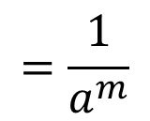




Index Laws
Activating Prior Knowledge
$$a^{m}×a^{n}$$
$$=a^{m+n}$$
$$a^{m}÷a^{n}$$
$$=a^{m−n}$$
$${\left(a^{m}\right)}^{n}$$
$$=a^{mn}$$
$${\left(ab\right)}^{m}$$
$$=a^{m}b^{m}$$
$$=\frac{1}{a^{m}}$$
$$a^{−m}$$

Slide 3







Rules of Derivative
Activating Prior Knowledge
$$f(x)$$ | $$f′(x)$$
$$x^{1}$$
$$x^{2}$$
$$x^{3}$$
$$x^{4}$$
$$x^{5}$$
$$⋮$$
$$x^{n}$$
$$1$$
$$2x$$
$$3x^{2}$$
$$4x^{3}$$
$$5x^{4}$$
$$nx^{n−1}$$

Slide 4

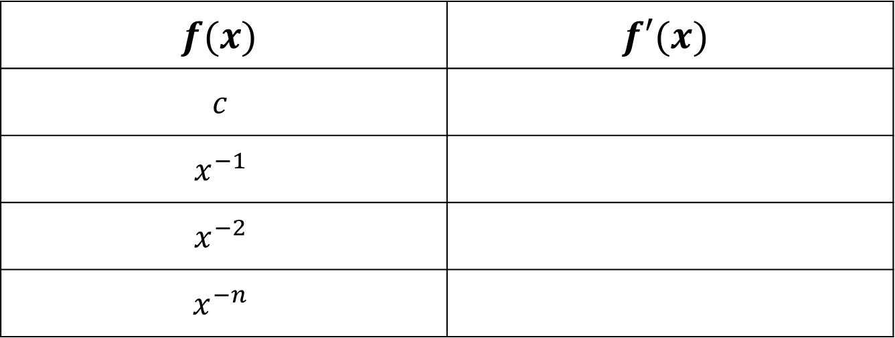



Rules of Derivative
Activating Prior Knowledge
$$f(x)$$ | $$f′(x)$$
$$c$$
$$x^{−1}$$
$$x^{−2}$$
$$x^{−n}$$
$$0$$
$$\left(−1\right)x^{−2}={−x}^{−2}$$
$$\left(−2\right)x^{−3}=−2x^{−3}$$
$$\left(−n\right)x^{−n−1}=−nx^{−n−1}$$

Slide 5
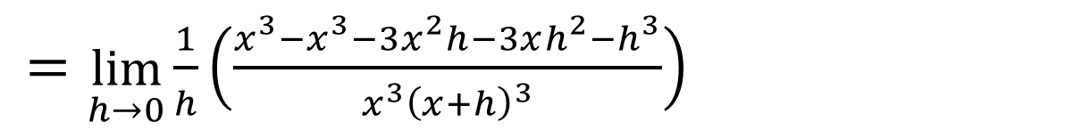

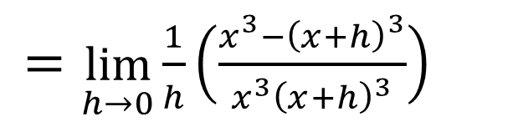
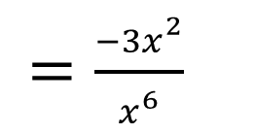
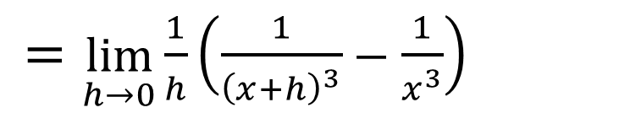
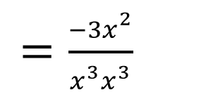
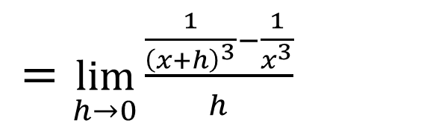
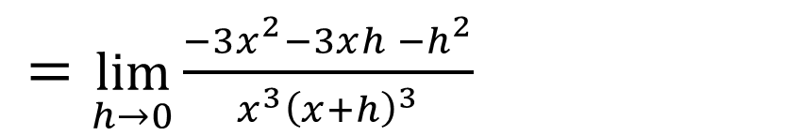
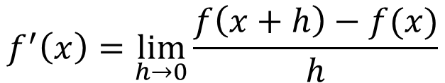
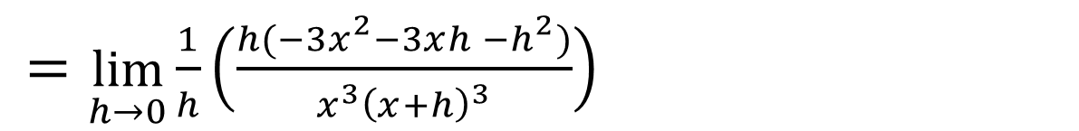
Guided Practice
Let $f\left(x\right)=x^{−3}, \left\{x∈ℝ:x≠0\right\}.$ Find $f′\left(x\right)$ by first principles
$$f^{′}\left(x\right)=\lim_{h→0}{\frac{f\left(x+h\right)−f(x)}{h}}$$
$=\lim_{h→0}{\frac{\frac{1}{{\left(x+h\right)}^{3}}−\frac{1}{x^{3}}}{h}}$
$=\lim_{h→0}{\frac{−3x^{2}−3xh^{ }−h^{2}}{{x^{3}\left(x+h\right)}^{3}}}$
$=\lim_{h→0}{\frac{1}{h}\left(\frac{1}{{\left(x+h\right)}^{3}}−\frac{1}{x^{3}}\right)}$
$=\frac{−3x^{2}}{{x^{3}x}^{3}}$
$=\lim_{h→0}{\frac{1}{h}\left(\frac{x^{3}−{\left(x+h\right)}^{3}}{x^{3}{\left(x+h\right)}^{3}}\right)}$
$=\frac{−3x^{2}}{x^{6}}$
$=\lim_{h→0}{\frac{1}{h}\left(\frac{x^{3}−x^{3}−3x^{2}h−3xh^{2}−h^{3}}{{x^{3}\left(x+h\right)}^{3}}\right)}$
$=−3x^{−4}$
$=\lim_{h→0}{\frac{1}{h}\left(\frac{h(−3x^{2}−3xh^{ }−h^{2})}{{x^{3}\left(x+h\right)}^{3}}\right)}$

Slide 6


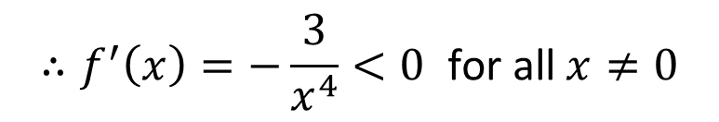
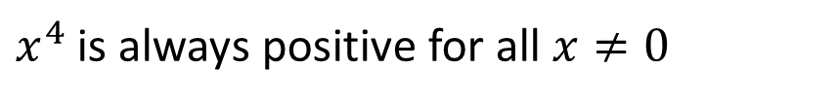

Guided Practice
Show that the derivative of the function $f\left(x\right)=x^{−3}, \left\{x∈ℝ:x≠0\right\}$ is always negative.
$$f^{′}\left(x\right)=−3x^{−4}$$
$$=−\frac{3}{x^{4}}$$
$x^{4}$ is always positive for all $x≠0$
$${∴f^{′}\left(x\right)=−\frac{3}{x^{4}}<0}^{ }\text{for} \text{all} x≠0$$

Slide 7

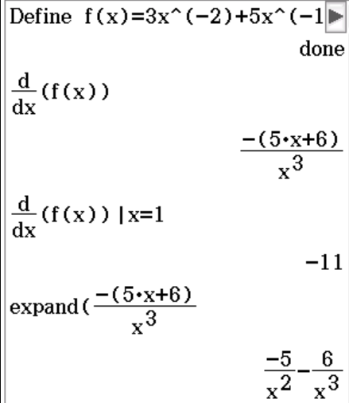

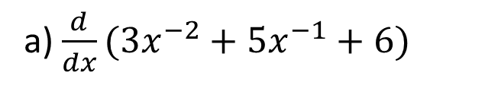

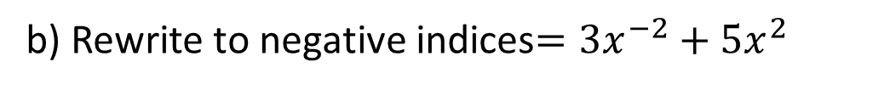



Guided Practice
a) $\frac{d}{dx}(3x^{−2}+5x^{−1}+6)$
b) Rewrite to negative indices$={3x}^{−2}+5x^{2}$
$$=3\left(−2\right)x^{−3}+5\left(−1\right)x^{−2}$$
$$\frac{d}{dx}({3x}^{−2}+5x^{2})$$
$$f^{′}\left(x\right)=−6x^{−3}−5x^{−2}$$
$$=3\left(−2\right)x^{−3}+5\left(2\right)x$$
$$=−6x^{−3}+10x$$

Slide 8

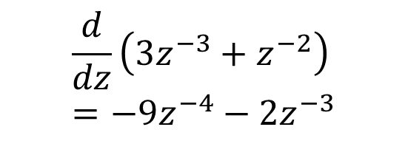


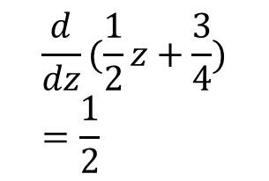
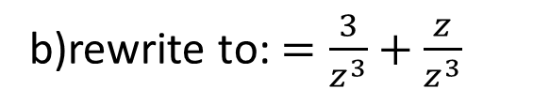


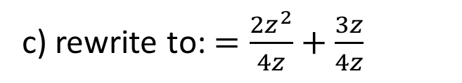
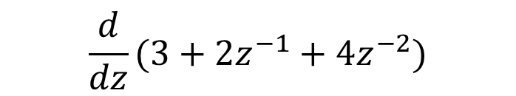
Guided Practice
a) rewrite to: $=\frac{3z^{2}}{z^{2}}+\frac{2z}{z^{2}}+\frac{4}{z^{2}}$
c) rewrite to: $=\frac{2z^{2}}{4z}+\frac{3z}{4z}$
$$\frac{d}{dz}(3+2z^{−1}+4z^{−2})$$
$$=\frac{1}{2}z+\frac{3}{4}$$
$$=−2z^{−2}−8z^{−3}$$
b)rewrite to: $=\frac{3}{z^{3}}+\frac{z}{z^{3}}$
$$\frac{d}{dz}(\frac{1}{2}z+\frac{3}{4})=\frac{1}{2}$$
$$=3z^{−3}+z^{−2}$$
$$\frac{d}{dz}\left(3z^{−3}+z^{−2}\right)=−9z^{−4}−2z^{−3}$$

Slide 9




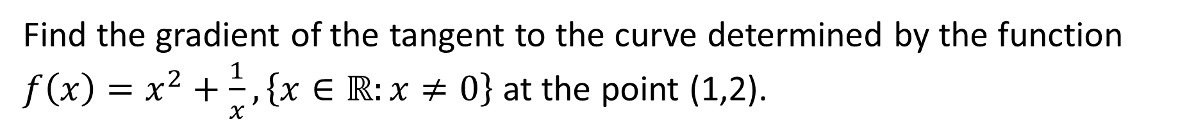
Guided Practice
Find the gradient of the tangent to the curve determined by the function $f\left(x\right)=x^{2}+\frac{1}{x}, \left\{x∈ℝ:x≠0\right\}$ at the point (1,2).
$$f\left(x\right)=x^{2}+x^{−1}$$
$$f^{′}(x)=2x−x^{−2 }$$
$$f^{′}(1)=2(1)−{(1)}^{−2 }$$
$$f^{′}(1)=1$$
The gradient of the curve is $=1$

Slide 10

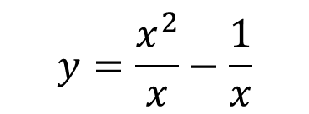
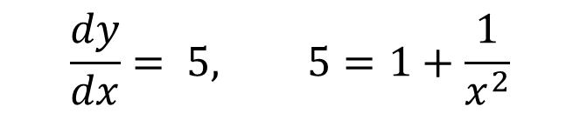
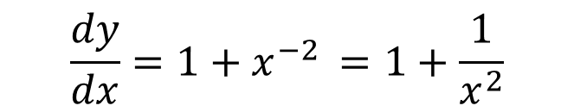

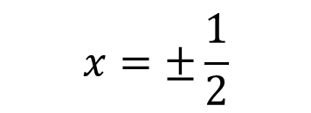


Guided Practice
Find the x-coordinates of the points on the curve $y=\frac{x^{2}−1}{x}$ at which the gradient of the curve is 5.
$$y=\frac{x^{2}}{x}−\frac{1}{x}$$
$$=x−x^{−1 }$$
$$\frac{dy}{dx}=1+x^{−2 }=1+\frac{1}{x^{2}}$$
$$\frac{dy}{dx}= 5, 5=1+\frac{1}{x^{2}}$$
$$4x^{2}=1$$
$$x^{2}=\frac{1}{4}$$
$$x=±\frac{1}{2}$$

Slide 11




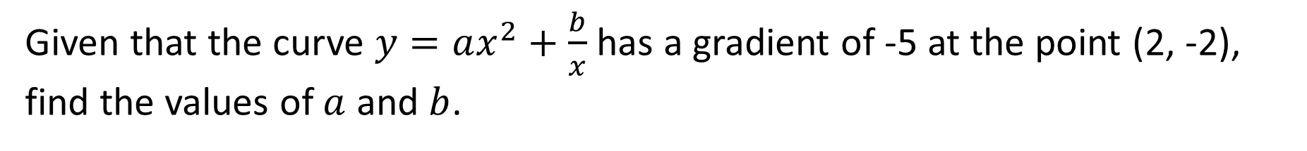
Guided Practice
Given that the curve $y=ax^{2}+\frac{b}{x}$ has a gradient of -5 at the point (2, -2), find the values of $a$ and $b$.
Subst. $\left(2,−2\right), −2=a{\left(2\right)}^{2}+\frac{b}{2}$
$$−4=8a+b −−(1)$$
$$\frac{dy}{dx}=2ax−bx^{−2}$$
$$=2ax−\frac{b}{x^{2}}$$
Subst. $\frac{dy}{dx}=−5, x=2, −5=2a(2)−\frac{b}{2^{2}}$
$$−20=16a−b −−(2)$$
$$a=−1, b=4 \\ y=−x^{2}+\frac{4}{x}$$
$$\left(1\right)+\left(2\right), −24=24a$$
$$a=−1$$
$$−4=8\left(−1\right)+b$$
$$b=4$$

Slide 12
Independent Practice
Complete Cambridge Ex 4C

